Slide 1
HUMAN DETECTION USING SMART CAMERA
BATCH NO - 5
22R01A05D1 A.Keerthana
22R01A05D2 B.Harika
22R01A05E0 E.Harsha
22R01A05E9 K.Harika
GUIDE - A. NAGESHWAR RAO

Slide 2
CONTENTS:
1. Introduction
2. Existing System and Dis-advantages
3. Problem Statement
4. Proposed System and Advantages
5. Requirements Analysis
6. Design
7. Implementation
8. Feasibility Study
9. Output
10. Conclusion and Future Scope
11. Reference

Slide 3
INTRODUCTION
The concept of a smart camera that exclusively detects human motion brings a myriad of applications and benefits to diverse industries and settings. By honing in on human activity, these cameras offer enhanced security, improved surveillance, and efficient monitoring systems while minimising false alarms triggered by non-human events. These cameras are tailored to respect individual rights while providing an added layer of protection.

Slide 4
EXISTING SYSTEM
The CCTV records everything and due to that lot of storage is consume
When the crime happens we have to go throw all the footage which takes lot of time

Slide 5
DIS -ADVANTAGES
Initial Cost: Smart cameras often come with higher upfront costs
compared to other traditional surveillance systems
Dependence on Connectivity: Smart cameras may rely on an internet
connection or cloud services for some features
False Alarms: The AI-based analytics in smart cameras can sometimes
lead to false alarms, triggering responses
Vulnerability to Hacking: Like any connected device, smart cameras are
susceptible to hacking and unauthorised access,

Slide 6
PROBLEM STATEMENT
Smart camera detects a person who is in the camera vision. When the person is detected ,it starts recording and when the person goes out of the camera vision it stops recording These recordings are stored in local database

Slide 7
PROPOSED SYSTEM
Our software helps in solving those problems.
It only records when there is any human activity. It stops recording after 5sec.
This helps in reducing storage and time.

Slide 8
ADVANTAGES
Enhanced Security: Smart cameras can detect and analyse suspicious
activities
Intelligent Analytics: It can identify and track objects, recognise faces,
and analyse data.
Cost-Effectiveness: These cameras can reduce operational costs
Real-time Response: can respond instantly to events, allowing for quick
actions in critical situations

Slide 9
The smart camera system must accurately detect humans in different environments and lighting conditions. It needs to quickly process detections and alert operators in real-time. Integration with current surveillance setups should be smooth, and the system must prioritize data security to protect privacy. Operators should find the interface easy to use for monitoring and adjusting settings. Clear documentation is essential for setting up, maintaining, and ensuring the system meets legal requirements.
Requirements Analysis

Slide 10
REQUIREMENTS
HARDWARE
SOFTWARE
Laptop with webcam / Desktop with camera
2 GB RAM minimum
Storage internal / external
Python 3.10.1
Visual studio code
OpenCV 4.5.4

Slide 11
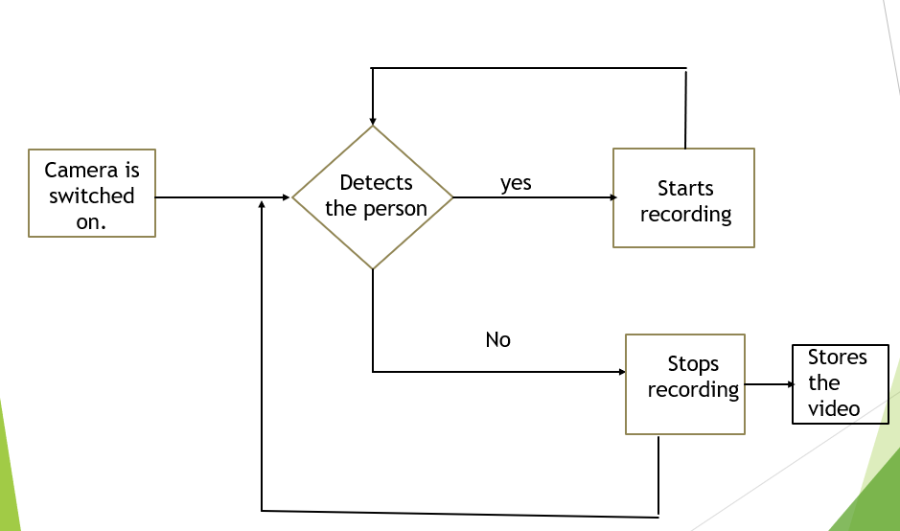
DESIGN :FLOW CHART

Slide 12
IMPLEMENTATION : ALGORITHM
1. Set up the camera.
2. Include Haar Cascade facial and body XML files.
3. Take the frames of the input video and covert into
gray scale.
4. If any body or face is detected in the frame
5. Then set detection as true
6. Start recording the video with file name as date and time.
7. Print start recording
8. If detection is false wait for 5 seconds and
stop the recording
9. Print Recording stopped !
10. Go to step 4 until ‘q’ is pressed

Slide 13
Feasibility Study
A feasibility study on human detection using smart cameras examines if it's practical and possible. These cameras use advanced technology to spot people accurately. They can help in various places like homes, offices, and public areas. The study checks if these cameras are reliable and cost-effective. It looks into how well they can improve safety and security.

Slide 14

OUTPUT
Person is detected when he is infront of smart camera. You can see the recording has been stored with date and time

Slide 15
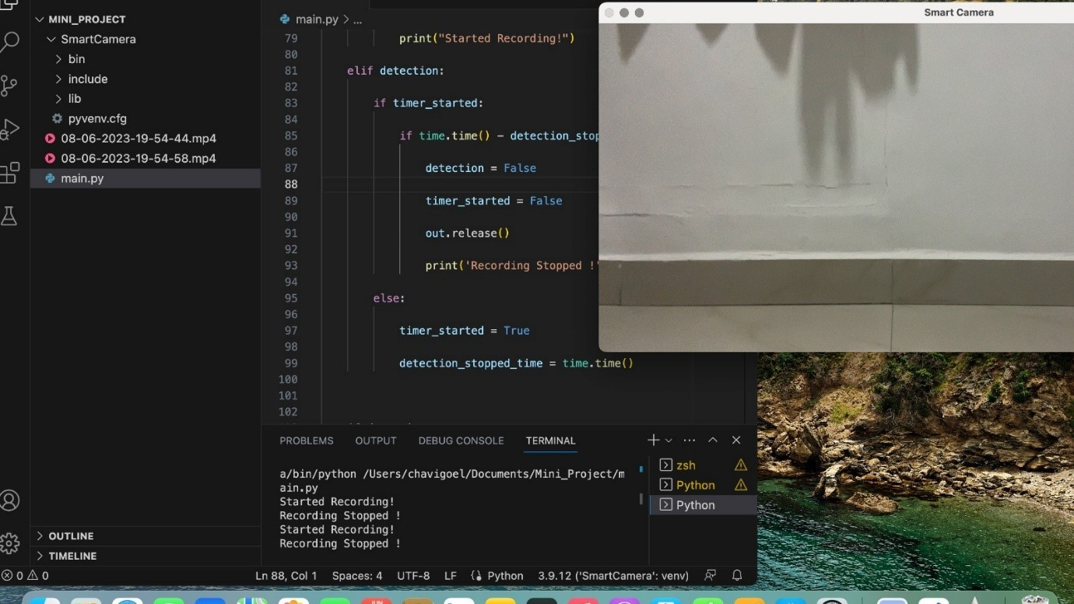
When there is no person the recording has been stopped and the video is saved in the local folder. We can see a notification saying the recording has been stopped.

Slide 16

The person face is not there in the camera vision, yet the recording has been started, as we used full body detection the body is getting detected

Slide 17
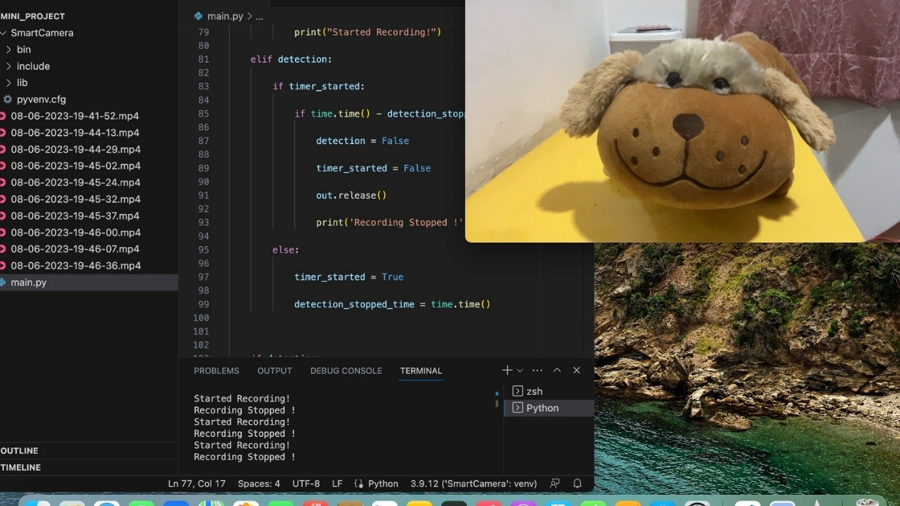
Sometimes it is being detected and mostly
its not detected. Sometimes it is detected
due to eyes.
Also identifies a person with mask.
If we show a picture of a person also it
identifies and starts recording.
Body detection is not so accurate.
Mostly cant detect animals , but in few
cases due to eyes it is detected as a human.

Slide 18
Conclusion and Future Scope
Smart camera enable the user to store the
video which is necessary.
Reduces the data to be stored.
Helpful in place of CCTV and also for
personal use
we can increase the surveillance system at a
very low cost and easy implementation.

Slide 19
REFERENCES
https://www.bing.com/ck/a?!&&p=824d1e70362fef1fJmltdHM9MTcxNDA4OTYwMCZpZ3VpZD0wNGI1OWY+using+smart+camera&u=a1aHR0cHM6Ly9pZWVleHBsb3JlLmllZWUub3JnL2RvY3VtZW50LzYwNDI5MjQv&ntb=1
REFERENCES
https://www.bing.com/ck/a?!&&p=b5cfeac55938f889JmltdHM9MTcxNDA4 OTYwMCZpZ3VpZD0wNGI1OWY0My1mMDQ4LTYwY
https://ieeexplore.ieee.org/search/searchresult.jsp?newsearch=true&queryText=human%20detection%20using%20smart%20camera

Slide 20
THANK YOU

